Slide 1
Senior Phase Options
Feb 2025

Slide 2
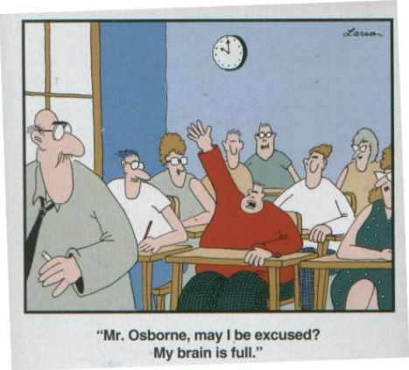

Slide 4
Headlines
Exam diet 25th April - 30th May 2025
Results day Tuesday 5th August 2025
Appeals
Fewer than 2 exams -

Slide 5
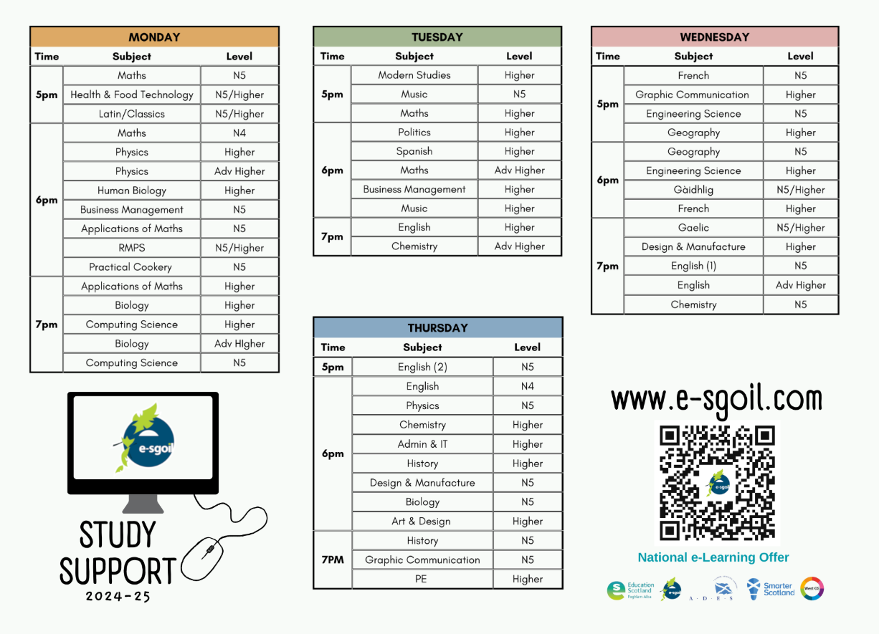

Slide 6
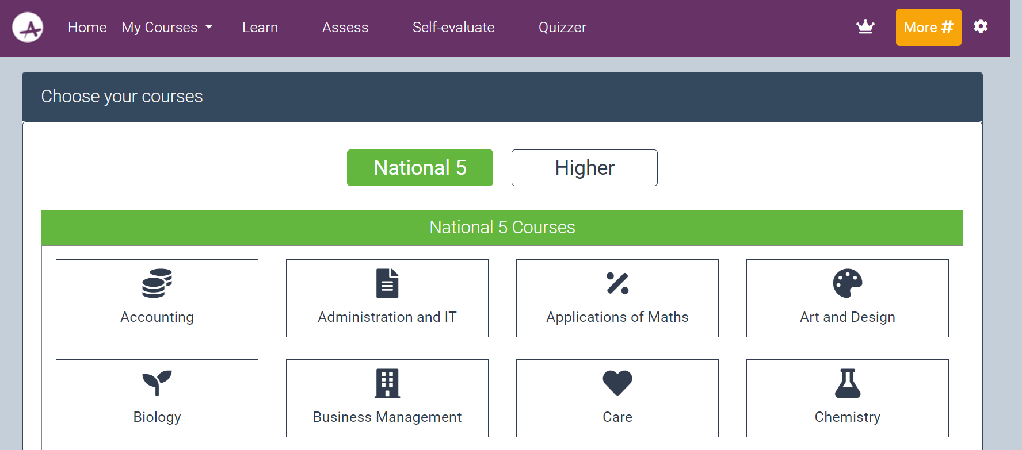
ACHIEVE RESOURCE

Slide 8
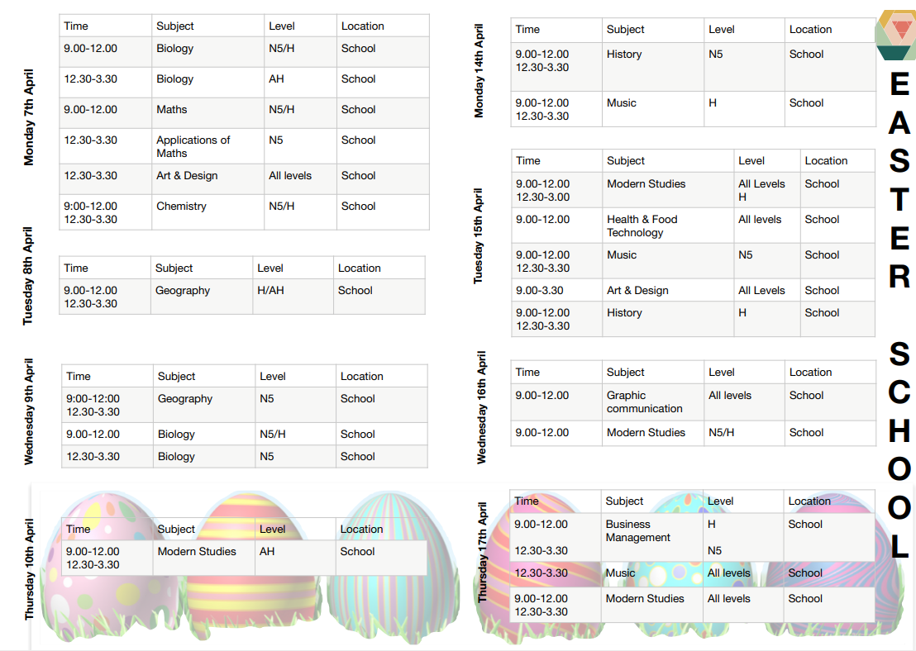

Slide 9
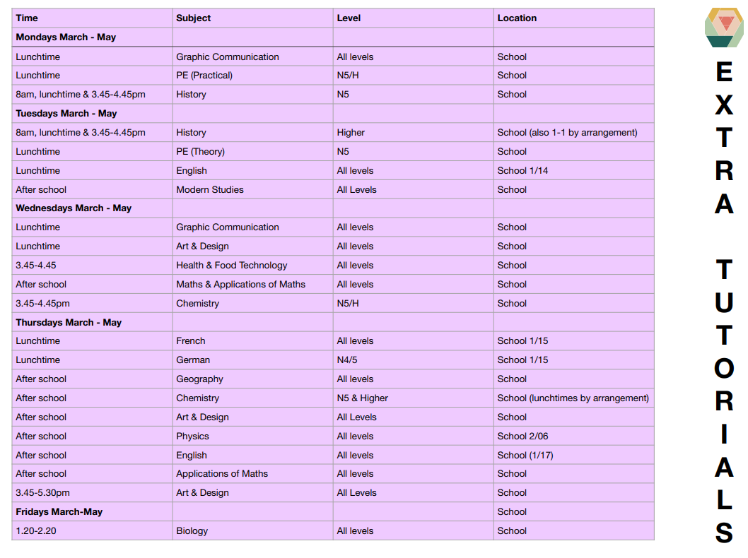

Slide 10
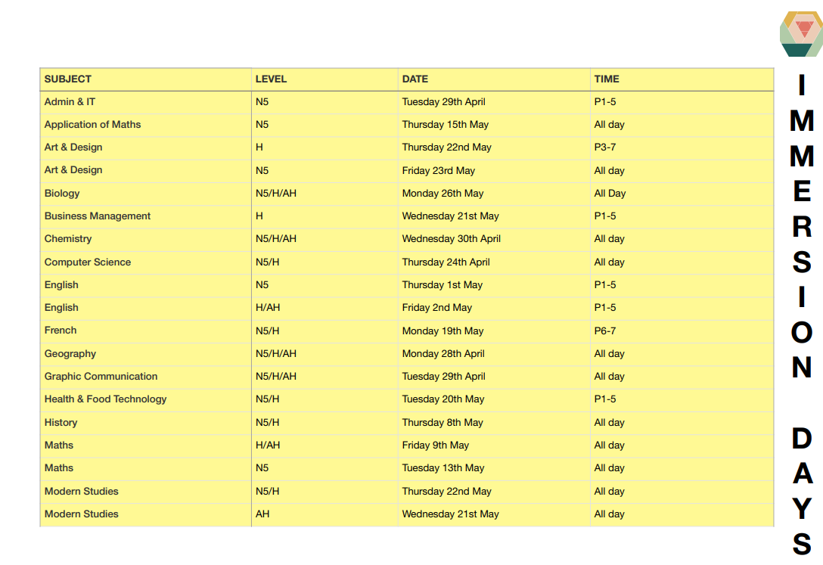

Slide 11
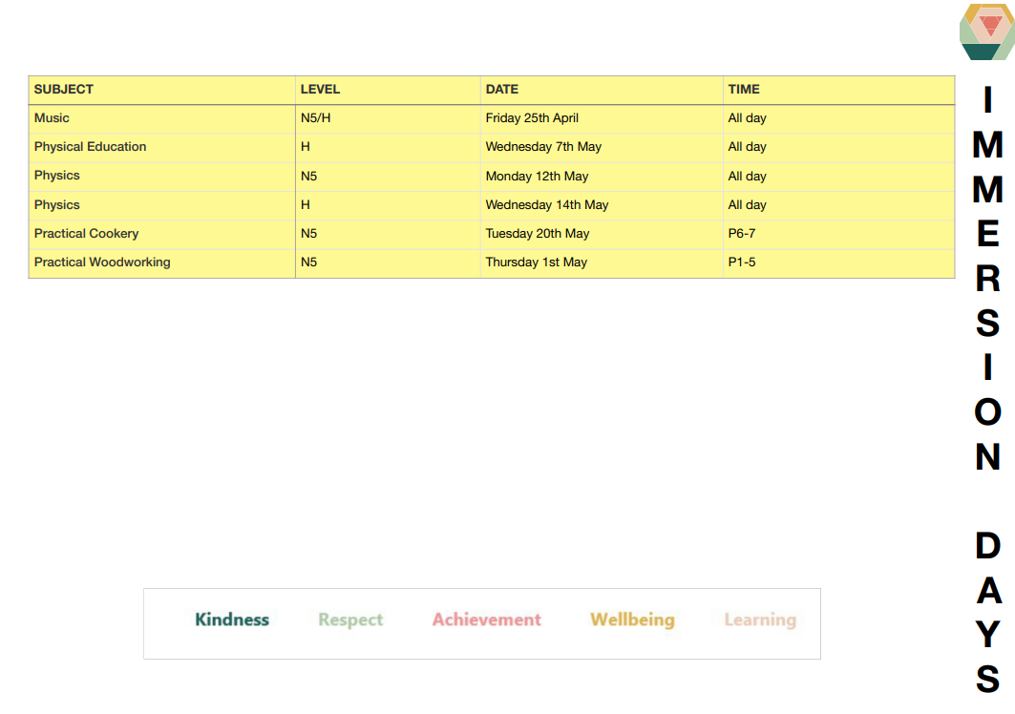

Slide 12
Attainment and Interventions Tracker
QA Change of Level Process
Raising Attainment Programme
Targeted Interventions
Positive Presentation Policy
Raising
Attainment

Slide 13
Options Process
Key Information
S4 – Choose English and Maths with 4 further Qualifications
S5 – Choose 6 Qualifications
5 Highers - You can choose supervised study in ONE column
S6 - Choose 6 Qualifications
One choice can be S6 Experience – Volunteering/Leaps Transition Course/Leadership Award/Study
Return Choices by 17th March 2025

Slide 14
S5 Choice Sheet

Slide 15
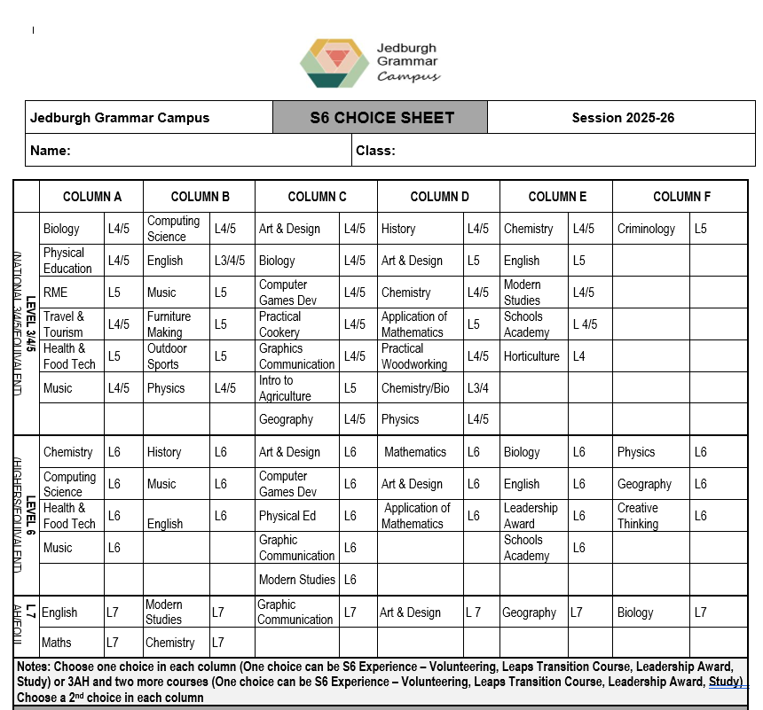
S6 Choice Sheet

Slide 17
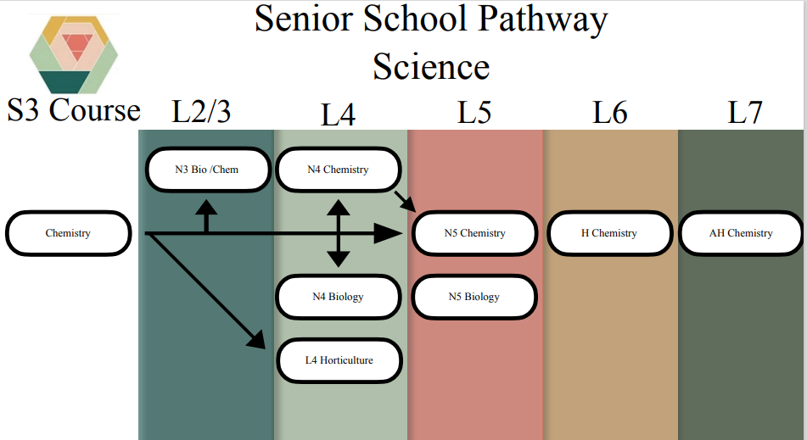

Slide 18
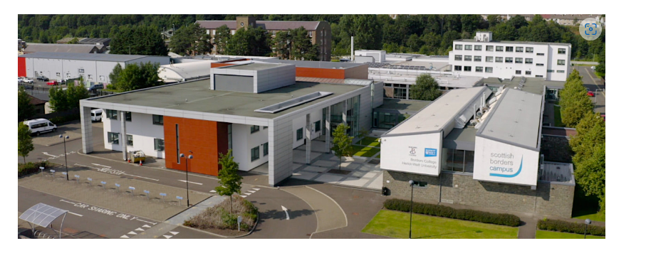

Slide 19
Borders College Schools Academy 2025/26
All run on a Friday 10.00-2.30p,
Please note that college students will have transportation to and from the school but as their return to JGC is after our school buses leave on a Friday, students will have to make their own way home.
Due to the timings you can only apply for 1 college course You can find these on: https://www.borderscollege.ac.uk/schools-academy
The Borders Schools Academy courses booklet link is: file:///N:/downloads/SchoolsAcademyBooklet2025.pdf
Please speak to your Pastoral Teacher if you want to select a Schools Academy course as one of your 6 choices.

Slide 20
Who can help?
Pastoral Teachers
JGC Senior Phase Pathways booklet
Most recent school report
Subject teachers
School website
Parents/Relatives
Friends
Employers
Training providers
My World of Work website
Planit+ website
UCAS website
DYW Website
Notes:
As well as the information from tonight…

Slide 21
Next STEPS
Students/parents/carers discuss course choice at home.
All current S3-S5 students will have a 1:1 meeting with their Pastoral teacher to discuss progression pathways.
Some students may have an enhanced transition meeting where parents and other partners are invited to discuss all available options.
Complete the Course Choice sheet.

Slide 22
Questions ?

Slide 23
Finally….

